Slide 1
Operating-System Structures
System Components
Operating System Services
System Calls
System Programs
System Structure
Virtual Machines

Slide 2
Common System Components
Process Management
Main Memory Management
File Management
I/O System Management
Secondary Management
Networking
Protection System
Command-Interpreter System

Slide 3
Process Management
A process is a program in execution. A process needs certain resources, including CPU time, memory, files, and I/O devices, to accomplish its task.
The operating system is responsible for the following activities in connection with process management.
Process creation and deletion.
process suspension and resumption.
Provision of mechanisms for:
process synchronization
process communication

Slide 4
Main-Memory Management
Memory is a large array of words or bytes, each with its own address. It is a repository of quickly accessible data shared by the CPU and I/O devices.
Main memory is a volatile storage device. It loses its contents in the case of system failure.
The operating system is responsible for the following activities in connections with memory management:
Keep track of which parts of memory are currently being used and by whom.
Decide which processes to load when memory space becomes available.
Allocate and deallocate memory space as needed.

Slide 5
File Management
A file is a collection of related information defined by its creator. Commonly, files represent programs (both source and object forms) and data.
The operating system is responsible for the following activities in connections with file management:
File creation and deletion.
Directory creation and deletion.
Support of primitives for manipulating files and directories.
Mapping files onto secondary storage.
File backup on stable (nonvolatile) storage media.

Slide 6
I/O System Management
The I/O system consists of:
A buffer-caching system
A general device-driver interface
Drivers for specific hardware devices

Slide 7
Secondary-Storage Management
Since main memory (primary storage) is volatile and too small to accommodate all data and programs permanently, the computer system must provide secondary storage to back up main memory.
Most modern computer systems use disks as the principle on-line storage medium, for both programs and data.
The operating system is responsible for the following activities in connection with disk management:
Free space management
Storage allocation
Disk scheduling

Slide 8
Networking (Distributed Systems)
A distributed system is a collection processors that do not share memory or a clock. Each processor has its own local memory.
The processors in the system are connected through a communication network.
Communication takes place using a protocol.
A distributed system provides user access to various system resources.
Access to a shared resource allows:
Computation speed-up
Increased data availability
Enhanced reliability

Slide 9
Protection System
Protection refers to a mechanism for controlling access by programs, processes, or users to both system and user resources.
The protection mechanism must:
distinguish between authorized and unauthorized usage.
specify the controls to be imposed.
provide a means of enforcement.

Slide 10
Command-Interpreter System
Many commands are given to the operating system by control statements which deal with:
process creation and management
I/O handling
secondary-storage management
main-memory management
file-system access
protection
networking

Slide 11
Command-Interpreter System (Cont.)
The program that reads and interprets control statements is called variously:
command-line interpreter
shell (in UNIX)
Its function is to get and execute the next command statement.

Slide 12
Operating System Services
Program execution – system capability to load a program into memory and to run it.
I/O operations – since user programs cannot execute I/O operations directly, the operating system must provide some means to perform I/O.
File-system manipulation – program capability to read, write, create, and delete files.
Communications – exchange of information between processes executing either on the same computer or on different systems tied together by a network. Implemented via shared memory or message passing.
Error detection – ensure correct computing by detecting errors in the CPU and memory hardware, in I/O devices, or in user programs.

Slide 13
Additional Operating System Functions
Additional functions exist not for helping the user, but rather for ensuring efficient system operations.
Resource allocation – allocating resources to multiple users or multiple jobs running at the same time.
Accounting – keep track of and record which users use how much and what kinds of computer resources for account billing or for accumulating usage statistics.
Protection – ensuring that all access to system resources is controlled.

Slide 14
System Calls
System calls provide the interface between a running program and the operating system.
Generally available as assembly-language instructions.
Languages defined to replace assembly language for systems programming allow system calls to be made directly (e.g., C, C++)
Three general methods are used to pass parameters between a running program and the operating system.
Pass parameters in registers.
Store the parameters in a table in memory, and the table address is passed as a parameter in a register.
Push (store) the parameters onto the stack by the program, and pop off the stack by operating system.

Slide 15
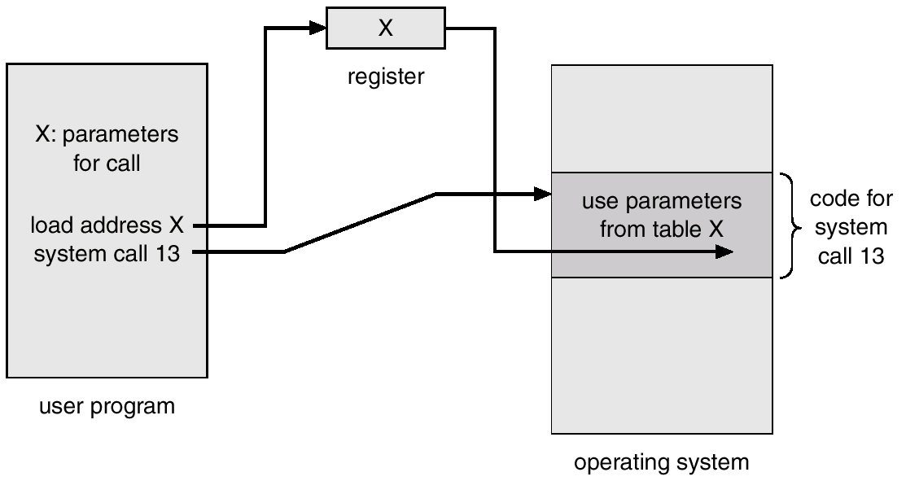
Passing of Parameters As A Table

Slide 16
Types of System Calls
Process control
File management
Device management
Information maintenance
Communications

Slide 17
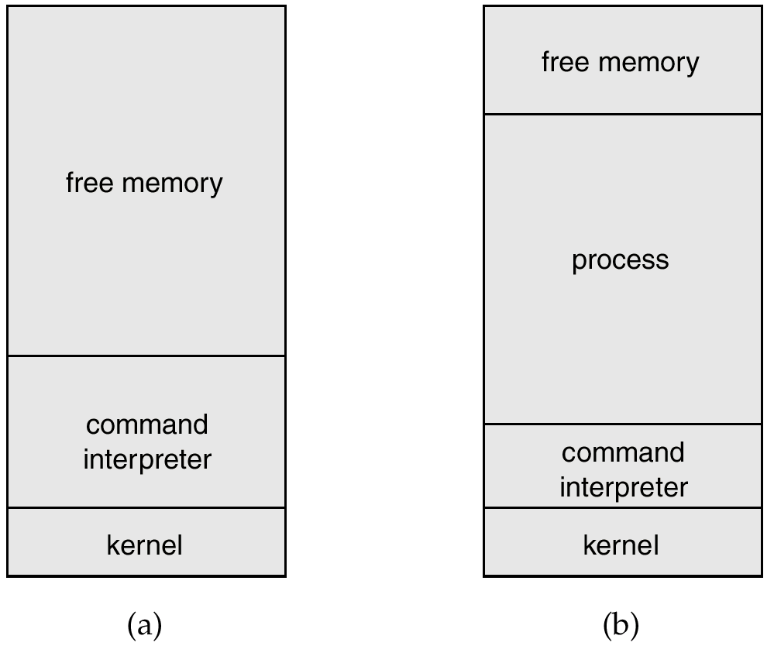
MS-DOS Execution
At System Start-up
Running a Program

Slide 18
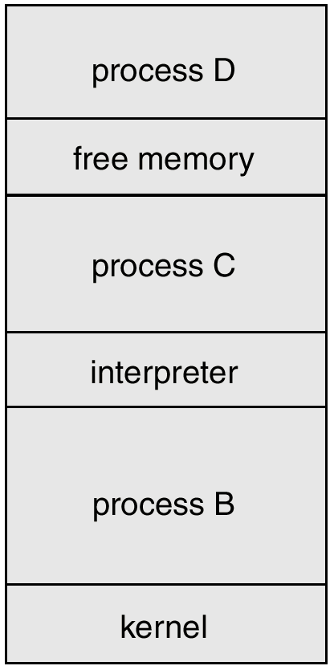
UNIX Running Multiple Programs

Slide 19
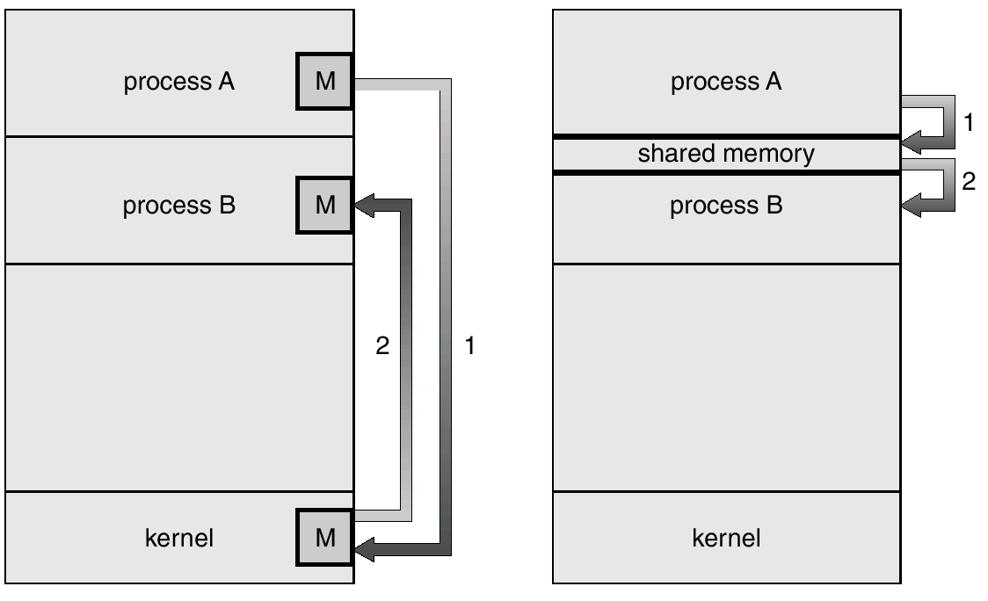
Communication Models
Communication may take place using either message passing or shared memory.
Msg Passing
Shared Memory

Slide 20
System Programs
System programs provide a convenient environment for program development and execution. The can be divided into:
File manipulation
Status information
File modification
Programming language support
Program loading and execution
Communications
Application programs
Most users’ view of the operation system is defined by system programs, not the actual system calls.

Slide 21
MS-DOS System Structure
MS-DOS – written to provide the most functionality in the least space
not divided into modules
Although MS-DOS has some structure, its interfaces and levels of functionality are not well separated

Slide 22
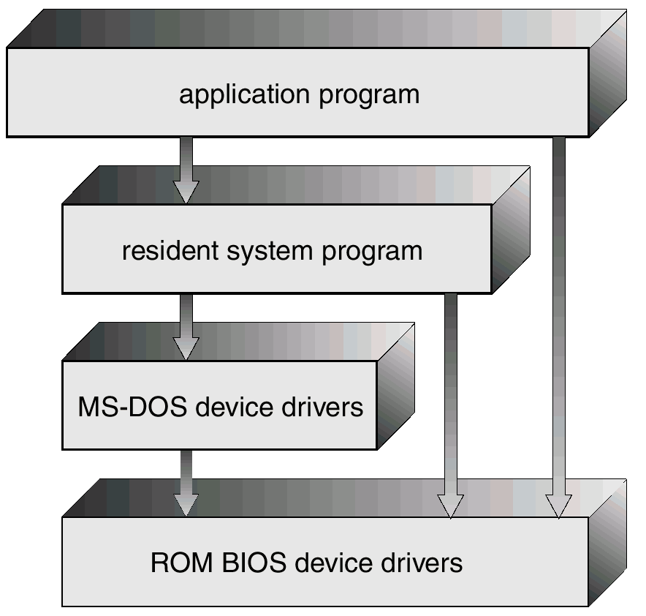
MS-DOS Layer Structure

Slide 23
UNIX System Structure
UNIX – limited by hardware functionality, the original UNIX operating system had limited structuring. The UNIX OS consists of two separable parts.
Systems programs
The kernel
Consists of everything below the system-call interface and above the physical hardware
Provides the file system, CPU scheduling, memory management, and other operating-system functions; a large number of functions for one level.

Slide 24
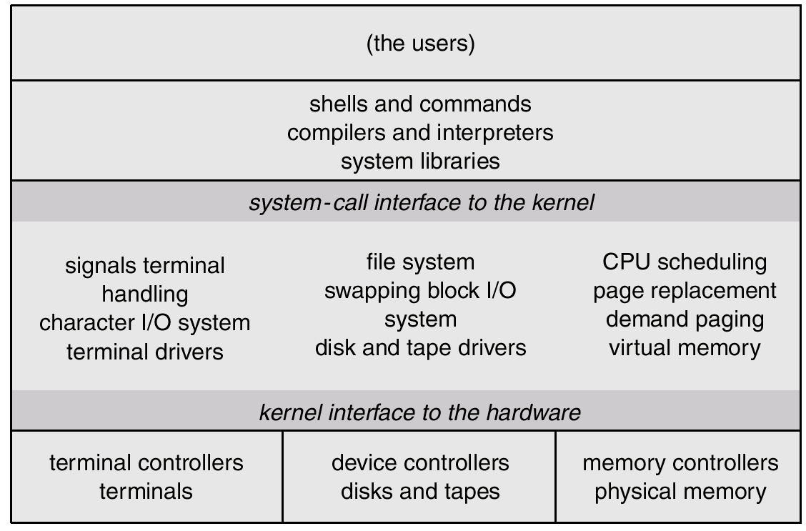
UNIX System Structure

Slide 25
Microkernel System Structure
Moves as much from the kernel into “user” space.
Communication takes place between user modules using message passing.
Benefits:
- easier to extend a microkernel
- easier to port the operating system to new architectures
- more reliable (less code is running in kernel mode)
- more secure

Slide 26
Virtual Machines
A virtual machine takes the layered approach to its logical conclusion. It treats hardware and the operating system kernel as though they were all hardware.
A virtual machine provides an interface identical to the underlying bare hardware.
The operating system creates the illusion of multiple processes, each executing on its own processor with its own (virtual) memory.

Slide 27
Virtual Machines (Cont.)
The resources of the physical computer are shared to create the virtual machines.
CPU scheduling can create the appearance that users have their own processor.
Spooling and a file system can provide virtual card readers and virtual line printers.
A normal user time-sharing terminal serves as the virtual machine operator’s console.

Slide 28
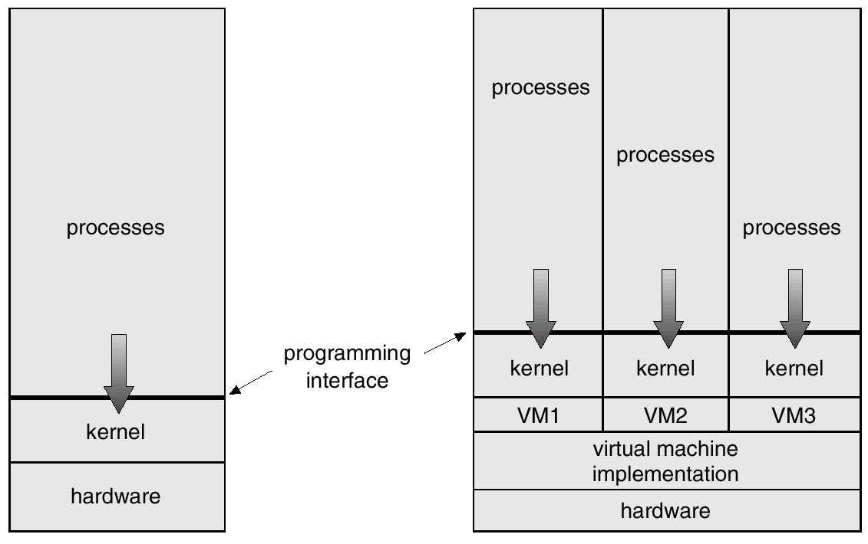
System Models
Non-virtual Machine
Virtual Machine

Slide 29
Advantages/Disadvantages of Virtual Machines
The virtual-machine concept provides complete protection of system resources since each virtual machine is isolated from all other virtual machines. This isolation, however, permits no direct sharing of resources.
A virtual-machine system is a perfect vehicle for operating-systems research and development. System development is done on the virtual machine, instead of on a physical machine and so does not disrupt normal system operation.
The virtual machine concept is difficult to implement due to the effort required to provide an exact duplicate to the underlying machine.

